Slide 1
General Meeting of the Lots Road Neighbourhood Forum
5.30 pm, Wednesday 21st February 2024
Worlds End Studios, 134 Lots Road, SW10 0RJ.

Slide 2
Agenda
Apologies for absence, matters arising and adoption of agenda.
Chair’s Introduction
Lots Road South Development
Q&A with Cllr Ben Coleman, Deputy Leader, Hammersmith & Fulham Council
New Local Plan Review
Battersea Bridge Safety Works
Plight of the Houseboats
NCIL applications and other local initiatives
A.O.B. and dates of future meetings

Slide 3
2. Chair’s Introduction

Slide 4
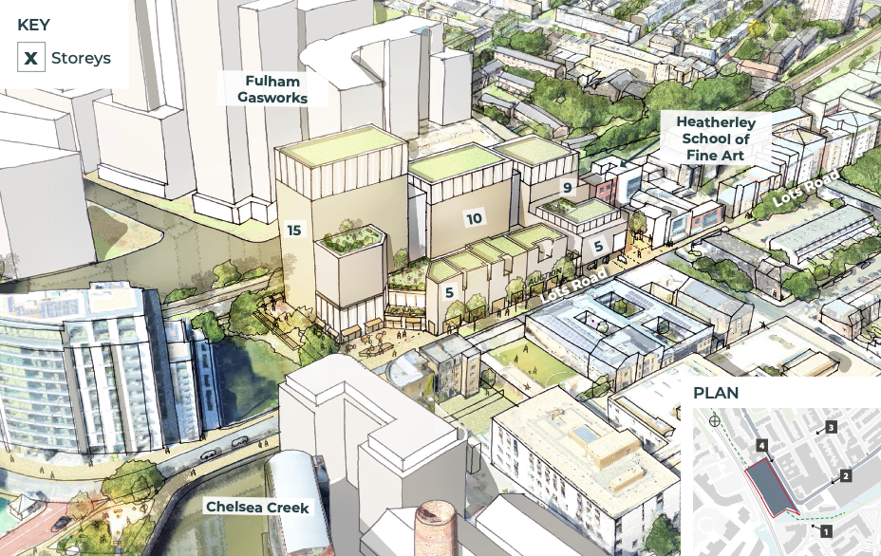
3. Mount Anvil’s Proposals for Lots Road South

Slide 5
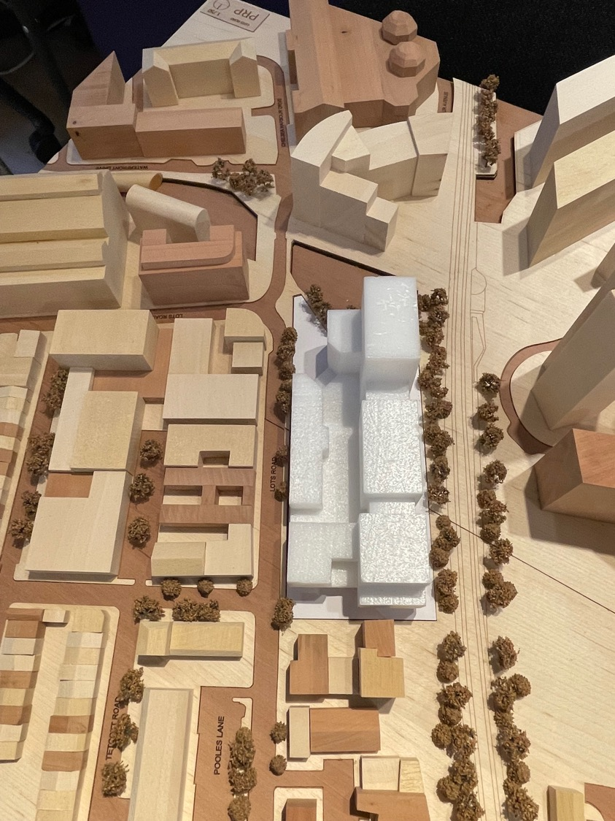
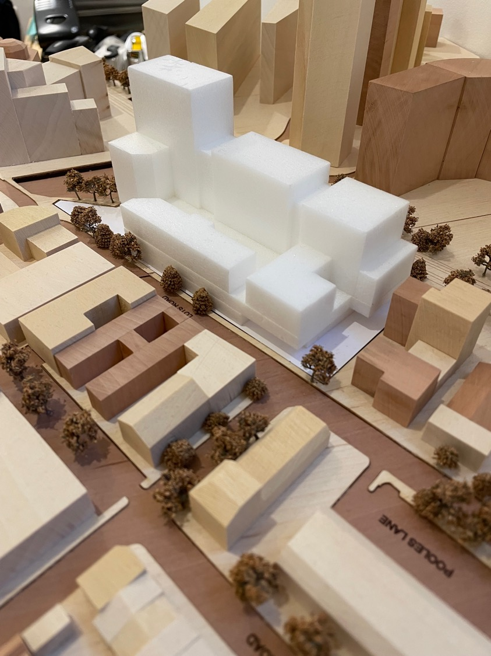

Slide 6
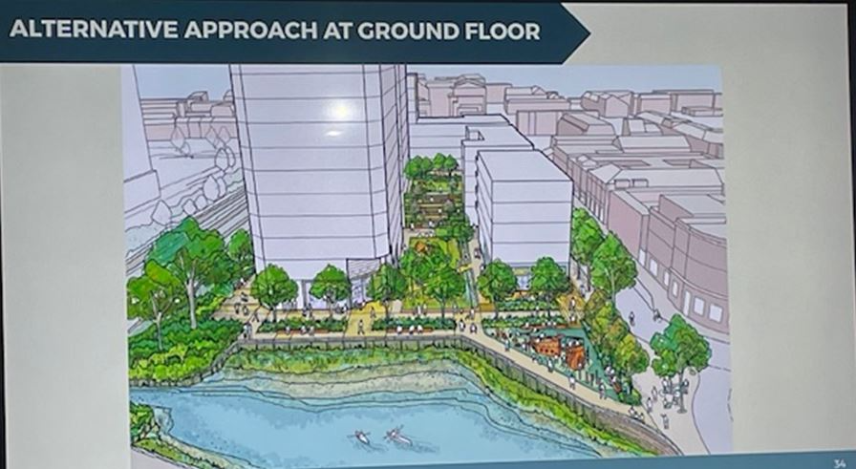

Slide 8
4. Q&A with Cllr Ben Coleman, Deputy Leader, Hammersmith & Fulham Council

Slide 9
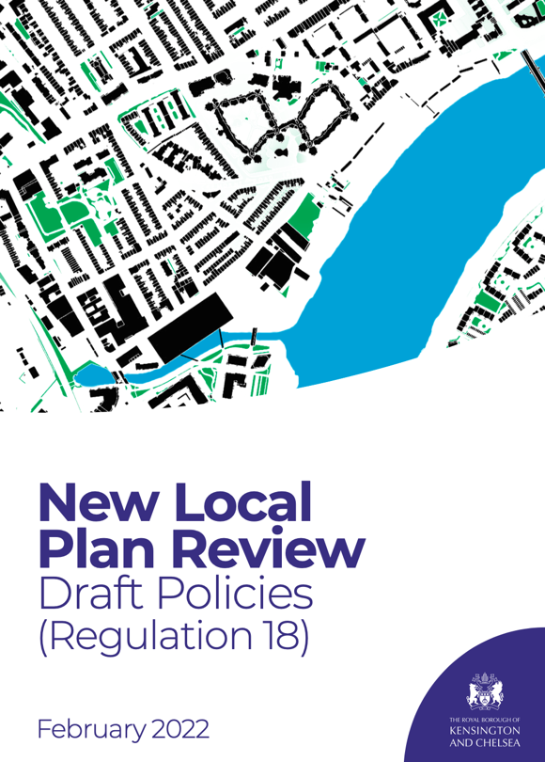
5. RBKC’s New Local Plan Review
Lots Road Neighbourhood Forum interventions:
NLPR Draft Policies (Regulation 18) Consultation
New Local Plan Review (NLPR) Publication Policies (Regulation 19) Consultation
Examination Of The Kensington And Chelsea New Local Plan Review: Statement From The Lots Road Neighbourhood Forum In Relation To Matters 1, 3, and 4 (SA6)
Public consultation on Main Modifications

Slide 10
Inspector’s Main Modifications
Following the public hearings and the representations from the Lots Road Neighbourhood Forum and others, the Inspector proposed the following Main Modifications to Site Allocation SA6, Lots Road South:
Criterion A: Amend to make explicit that any mixed-use development should be employment led with levels of residential consistent with the employment use of the site.
Criterion B: Amend to read, ‘A minimum of Around 100 new gross residential (C3) units.’.
Criterion C: Amend to read, ‘A minimum of Around 65 gross affordable extra care units’.
RBKC Proposed Main Modifications
In the RBKC consultation on the Main Modifications, which opened on 30th January 2024, RBKC officers have proposed the following wording:
MM311 252 SA6 A The site will deliver a high-quality mixed-use development that is employment led, to include residential and employment floorspace.
MM312 252 SA6 B Around A minimum of 100 or more new gross residential (C3) units.
MM313 252 SA6 C Around A minimum of 65 or more gross affordable extra care units.

Slide 11
Next Steps
DONE
LRNF complaint to the Planning Inspector and to RBKC CEO
LRNF Objection to the Public Consultation
PROPOSED
LRNF members to object during the Public Consultation, which closes 12 March.
Meeting with Beau Stanford-Francis, Executive Director for Environment and Neighbourhoods scheduled for 15th April.

Slide 12
6. Battersea Bridge Safety Works
At the northern end of Battersea Bridge, TFL propose:
Introducing green-man crossings on all remaining arms of the junction – on Cheyne Walk, Chelsea Embankment and Beaufort Street
Making improvements for cyclists at the junction including dedicated cycle signals and a section of westbound segregated cycle track
Building a new section of westbound bus lane from Royal Hospital Road to the bus stop at Beaufort Street to mitigate delays to bus journeys. A new eastbound bus lane was also proposed from the junction of Beaufort Street to the stop just west of the junction with Old Church Street
Banning the left-hand turn into Beaufort Street at the junction with Battersea Bridge to reduce delays and wait times for all traffic at the junction, and improve safety by eliminating the risk of left turning vehicles colliding with cyclists.

Slide 13
Response of the CWT and Chelsea Society:
Make safe for all traffic modes approaches to and movement on Battersea Bridge with green man controls as a priority
Remove systemic actual and proposed flaws such as the emergency traffic scheme north and south turn bans at Chelsea Bridge/Chelsea Embankment, proposed traffic constraining Bus Lanes and the arbitrary left turn north vehicle ban into Beaufort Street
Measure and evaluate present transport and accident data for all modes on the key routes and junctions of Chelsea Embankment and Cheyne Walk
Evolve an equable overall traffic management scheme for shared transport modes that avoids unfair constraints or additional traffic displacement and consult this with stakeholders
Review safety for cyclists on Battersea Bridge by considering the scope to dedicate one footway for pedestrians and the other for cyclists, both in bi-directional mode.

Slide 14
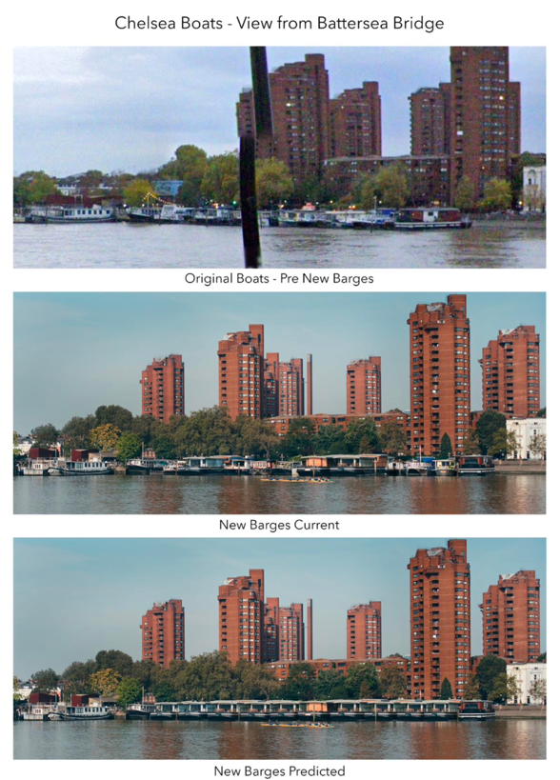
7. Plight of the Houseboats
Developments since our AGM:
Planning Applications Committee Meeting on 19th December rejected analysis of RBKC officers and agreed there was a breach of planning controls
Full Council meeting on 31st January approved Ward Councillors resolution to to complete the River Thames Conservation Area Management Plan
Planning Applications Committee scheduled for 27th February to consider RBKC officers’ further paper arguing there is still no basis for planning enforcement.

Slide 15
Draft Lots Road Neighbourhood Forum Resolution
‘The Lots Road Neighbourhood Forum believes that RBKC officers in their Report S20 ENF/23/05465 are wrong in matters of fact and judgement. Among the most egregious errors:
Officers base their evaluation (Section 8) on their repeated assertion that the three boats in question are ‘not excessively large’ or out of character with other vessels on the mooring. Yet it is admitted that these boats are several metres longer than the next largest boats. They are also wider than the next largest boats, twice the volume of most of the boats of the mooring and each split into two apartments unlike the other boats on the mooring. These facts, along with the views of residents on the unacceptable intrusion into the visual amenity of the Conservation Area, do not support the officers’ evaluation.
Officers argue that intensification created by these new apartment boats, with the addition of up to 24 new car parking permits and 24 new motorcycle permits, is unlikely to have a significant impact on traffic congestion and on street parking. The officers offer no traffic study to support this conclusion, a claim which runs contrary to the clear views of residents that such intensification would add significantly to the congestion of a highly constrained part of the borough.
Lastly, at Section 5.6 officers claim to have considered the views expressed by residents in their assessment of whether enforcement action should be taken, yet they show no evidence of how these views have been addressed and their judgements at every point contradict the views and concerns of the local community.
In light of the above, the Lots Road Neighbourhood Forum calls on members of the RBKC Planning Applications Committee (PAC) to reject the views of RBKC officers and to order immediate enforcement to remedy the breach of planning control unanimously resolved by the PAC at its meeting held on 19th December 2023 and supported unanimously by the Full Council at its meeting held on 31st January 2024 when it resolved urgently to complete work on the River Thames Conservation Area Management Plan to protect Chelsea Riverside Ward further from overdevelopment along the Chelsea foreshore.’

Slide 16
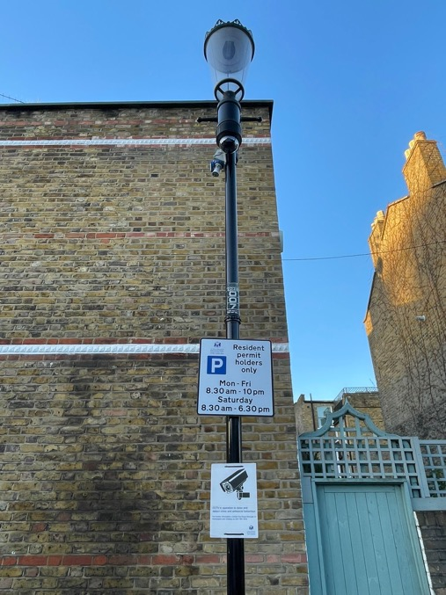
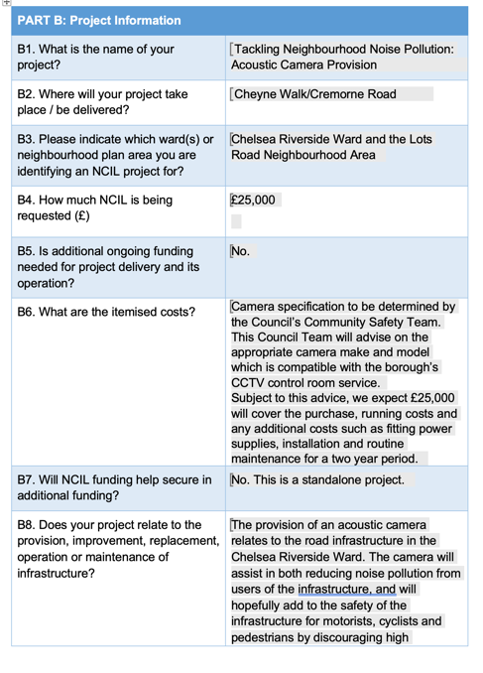
8. NCIL applications and other local initiatives
First CCTV camera installed in Tadema Road
Acoustic Camera still waiting for installation

Slide 17
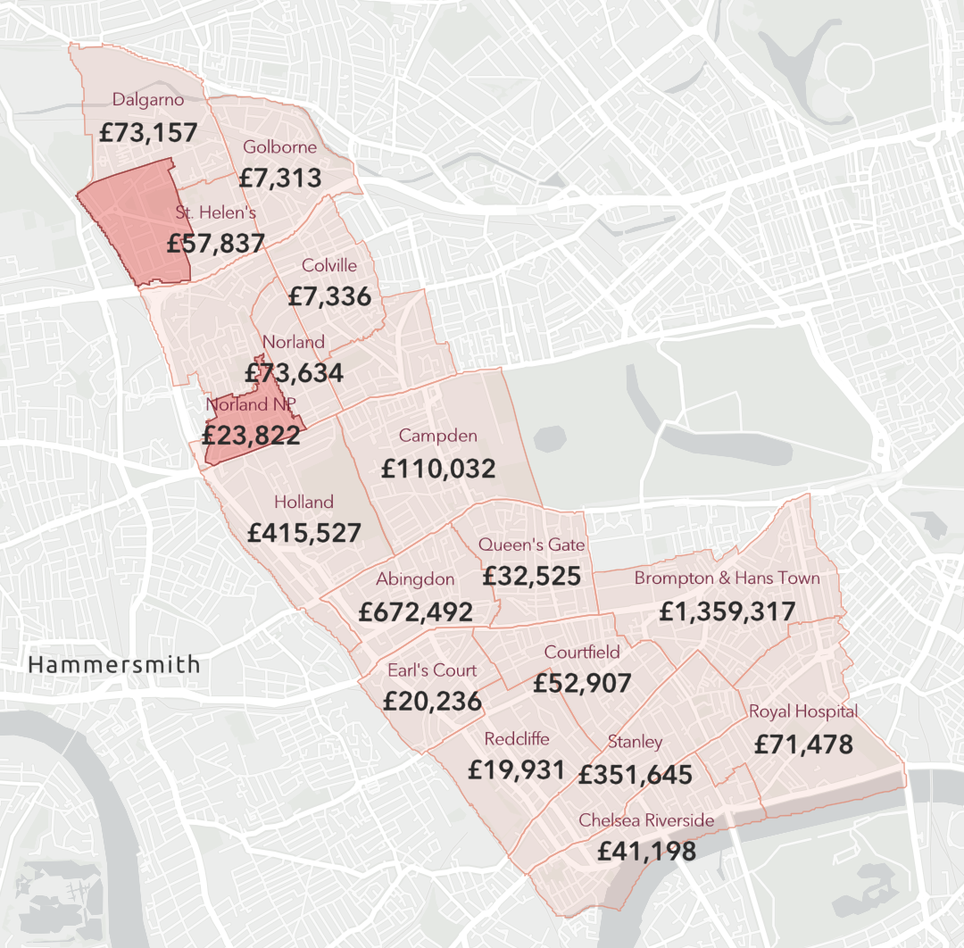
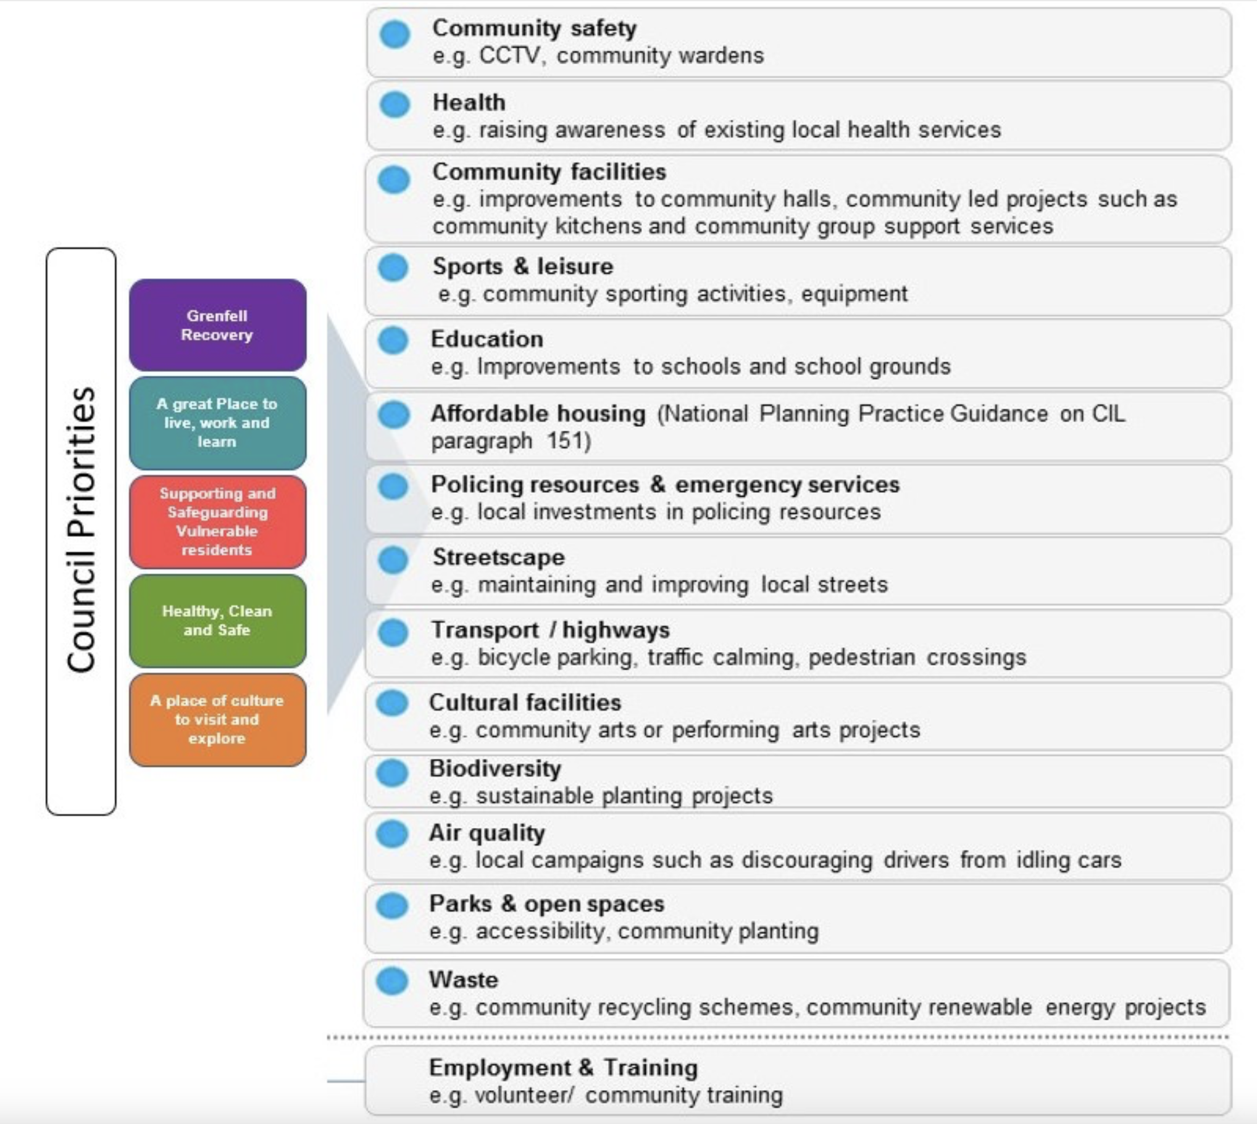
Neighbourhood Community Infrastructure Levy (NCIL)
Funding is available to spend on local infrastructure priorities. £3.52mn is available across RBKC as of January 2024 for funding in Round 5.

Slide 18
9. A.O.B. and dates of future meetings
Friday 22nd March - 5.30pm - at which we will have The Rt Hon Greg Hands MP, our current MP who will be standing again at the next election
Wednesday 24th April - 5.30pm at which we will have Blaise Baquiche, our Liberal Democrat parliamentary candidate

